Slide 1






PRESENTATION 2026
Client Financial Risk analysis using Lakehouse
Mentor Name
Student Name
Student Email
Uma maheshwari
K.Bhavya
bhavyakandula40@gmail.com

Slide 2

Outline
Abstract of the Project
Problem Statement
Proposed Solution
System Architecture
Live Demo of the Project
Embedded Video of Project
Conclusion
Future Scope

Slide 3

Abstract
Analyze banking customer data to understand n insights through dashboards.
Key highlight: Combines AI with business intelligence tools for smarter an financial behavior, spending patterns, and risk levels.
Objective is to convert raw data into meaningful insights for better decision-making.
Uses Microsoft Excel for data cleaning and preprocessing.
Uses Power BI to create interactive dashboards and visualizations.
Integrates AI tools like Copilot for insights and report generation.
Identifies high-value customers and detects potential financial risks.
Provides clear, data-drived more efficient analysis.

Slide 4

l
Problem Statement
High-volume banking data lacks advanced analytics and integration for actionable insights.
No real-time processing or dashboards limits KPI visibility.
.
Manual processing and static reporting cause delays, inefficiencies, and errors.
Lack of AI (NLP) copilots restricts easy data interpretation for business users.
No unified Lakehouse leads to data silos and fragmented systems.
Absence of Lakehouse limits integration of structured and unstructured data for analytics.

Slide 5

Proposed Solution
Implement advanced analytics and real-time data processing to transform banking data into actionable insights.
Develop interactive Power BI dashboards for visualization of key financial KPIs.
Build predictive analytics and risk scoring models to identify high-risk customers.
Automate data cleaning and reporting to reduce manual effort, delays, and errors.
Integrate a centralized Lakehouse architecture to store, manage, and process structured and unstructured banking data efficiently.
Integrate an AI-powered (NLP-based) Copilot Studio for easy and intuitive data interpretation.

Slide 6
System Architecture
Data Input / Source
Processing / Analysis
Real includes key details like demographics, account types, balances, income, and credit score.
Acts as the primary input for financial analysis and insights generation.
Data is directly uploaded into Excel and Power BI for processing.
Raw data is refined in Excel by removing duplicates and fixing missing values.
Data is standardized and structured to ensure accuracy and consistency.
Data is organized using sorting, filtering, and conditional formatting techniques.
AI / Tool Integration
Output / Dashboard
Excel is used for data cleaning, preprocessing, and basic analysis.
Power BI is connected to Excel data to build interactive dashboards and visualizations.
AI tools like Copilot are used to generate insights and summaries.
Final output is an interactive Power BI dashboard.
Displays charts, graphs, and KPI indicators for analysis.
Provides clear insights into customer segments and risk levels.

Slide 7
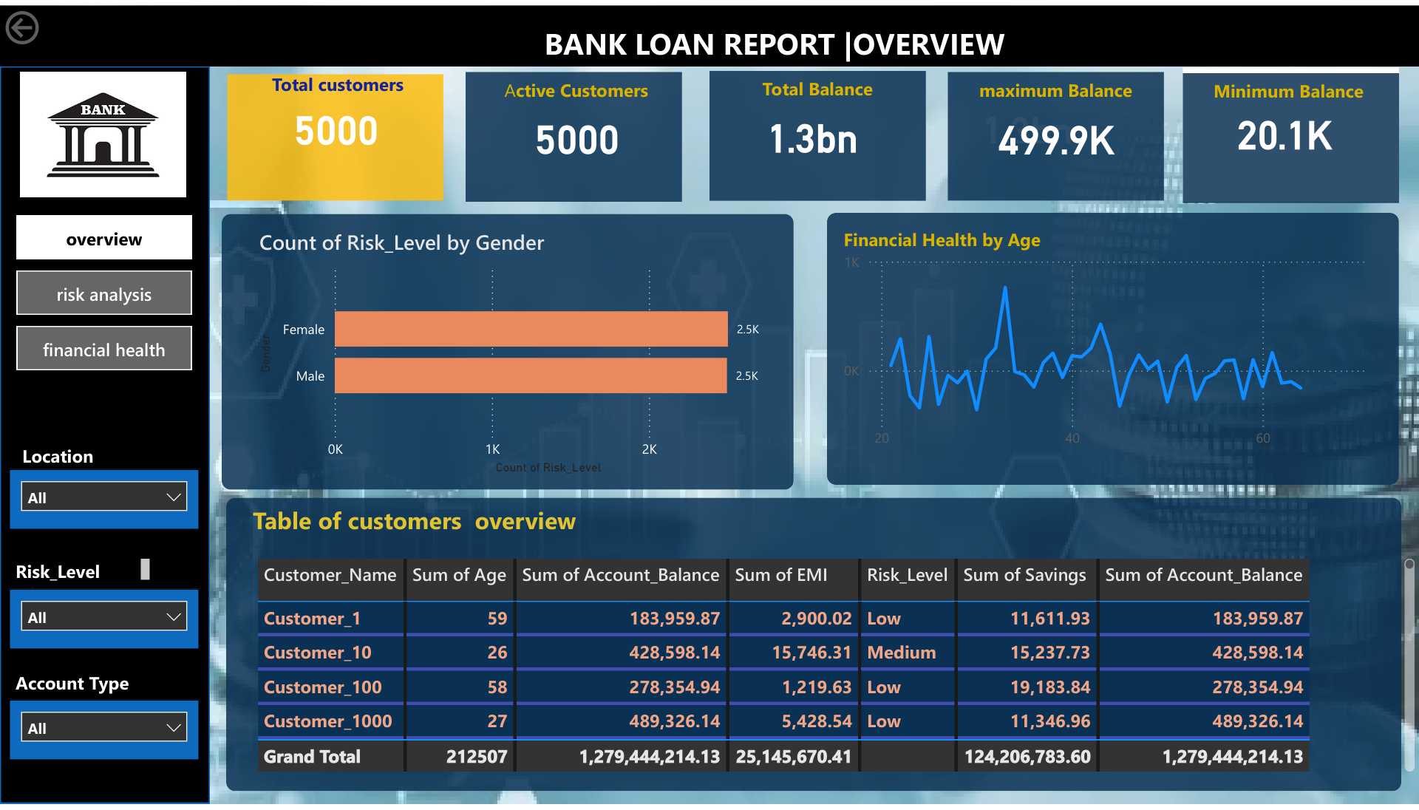
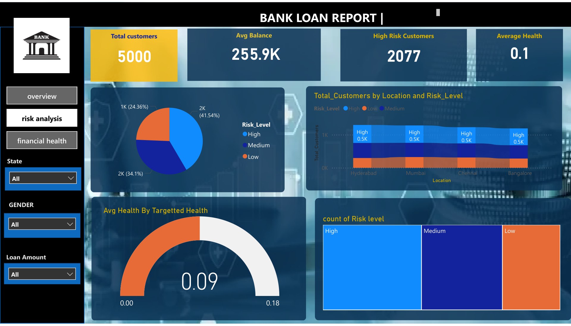
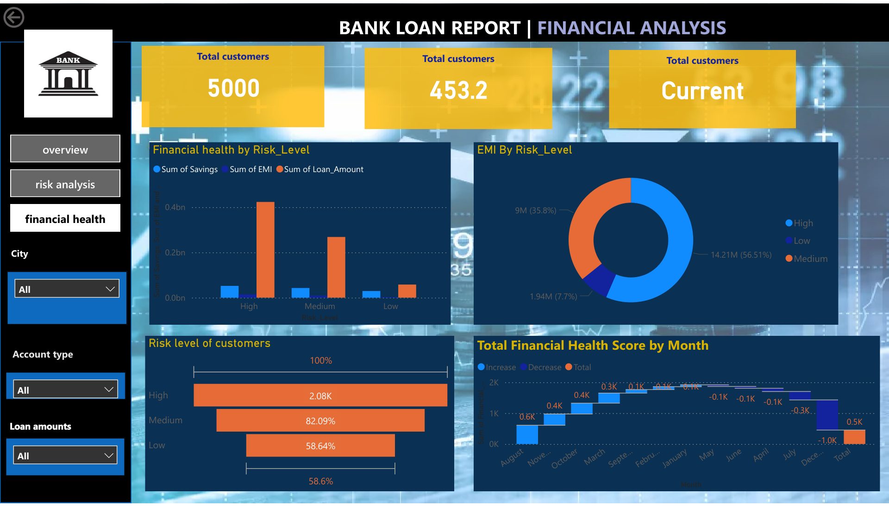
Live Demo of Project
Here's the list of some demo screenshots / features of the project:
Demo 1
Customer overview
Risk & Loan Analysis
Financial Insights
Demo 2
Demo 3

Slide 8
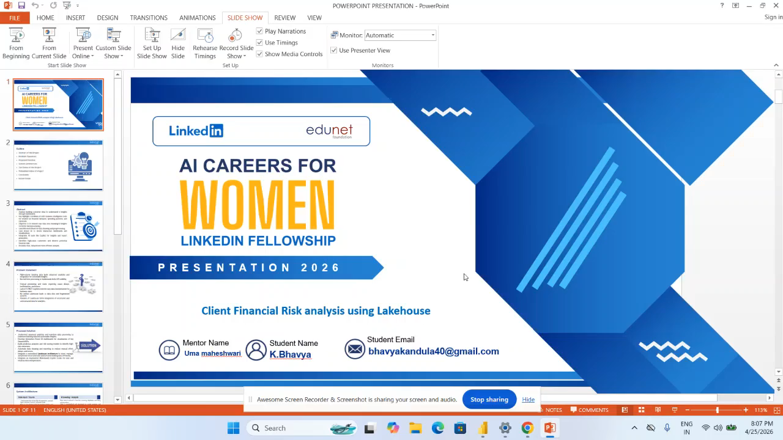
Video of Project Demo
▶
[Insert your project demo video.
You can embed a video your live project.]

Slide 9

Conclusion
Developed a banking dashboard to analyze customer behavior and assess risk levels.
Utilized Excel and Power BI to generate meaningful and actionable insights.
Identified key customer trends and potential financial risks.
Implemented interactive dashboards with real-time filtering for better user experience and deeper data exploration.
Enhanced decision-making capabilities using data-driven and AI-powered tools.
CONCLUSION

Slide 10

Future Scope
The future scope of this project includes integrating real-time banking data for live analysis and updates. Machine learning techniques can be applied to enhance predictive insights and risk analysis. The dashboard can be further improved with advanced Power BI features and automation. Additionally, the system can be expanded into a web-based or mobile platform to improve accessibility and user experience

Slide 11
Thank You
AICW Fellowship | Student Project Presentation 2026
LinkedIn | Edunet Foundation

